Slide 1

Number System Conversion
Presented By:
Elizer Ponio Jr. Department of Computer Science
College of Computing and Information Technologies

Slide 2
Recap: Binary System
The binary number system uses only two digits: 0 and 1.
Digits 0 and 1 are called bits and 8 bits together make a byte.
The data in computers is stored in terms of bits and bytes.
The binary number system does not deal with other numbers such as 2,3,4,5 and so on.
For example: 100012, 1111012, 10101012 are some examples of numbers in the binary number system.

Slide 3
Units of Measure
Unit | Equivalent
bit | 1 bit
byte | 8 bits
1 kilobyte (KB) | 1,024 bytes
1 megabyte (MB) | 1,048,576 bytes
1 gigabyte (GB) | 1,073,741,824 bytes
1 terabyte (TB) | 1,099,511,627,776 bytes
1 petabyte (PB) | 1,125,899,906,842,624 bytes

Slide 4
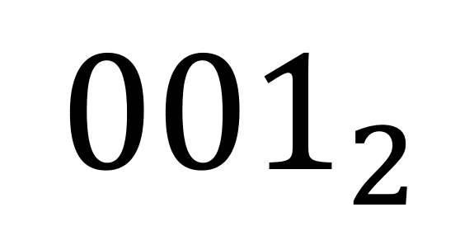
Binary
In the binary number system, we only use two digits 0 and 1.
0 | 1
It means a 2 number system.
The binary number system uses Base 2.
$${001}_{2}$$
Subscripts are used to indicate a base

Slide 5
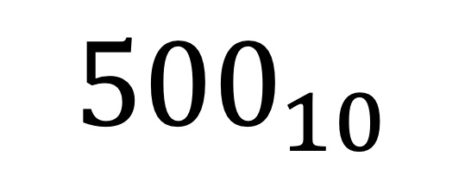
Decimal
The decimal number system consists of 10 digits.
0 | 1 | 2 | 3 | 4 | 5 | 6 | 7 | 8 | 9
It is the number system that we generally use to represent numbers in real life.
A decimal number system is also called the Base 10 system.
If any number is represented without a base, it means that its base is 10
$${500}_{10}$$
Subscripts are used to indicate a base

Slide 6
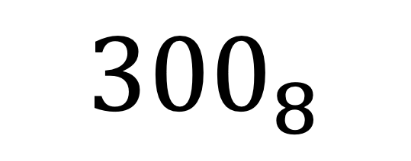
Octal
The octal number system uses eight digits, 0 through 7, to represent numbers.
0 | 1 | 2 | 3 | 4 | 5 | 6 | 7
It is commonly used in computer programming and digital electronics.
A decimal number system is also called the Base 8 system.
$${300}_{8}$$
Subscripts are used to indicate a base

Slide 7

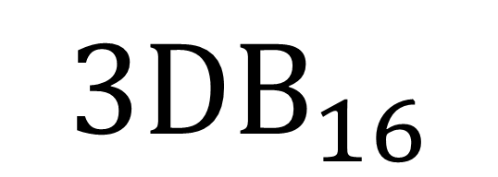
Hexadecimal
The word hexadecimal comes from Hexa meaning 6 and decimal meaning 10.
In a hexadecimal number system, there are 16 digits
0 | 1 | 2 | 3 | 4 | 5 | 6 | 7 | 8 | 9 | A | B | C | D | E | F
It consists of digits 0 to 9 and then has first 6 letters of the alphabet A to F.
it is also known as the base 16 number system
$${3DB}_{16}$$
Subscripts are used to indicate a base

Slide 8
Number System Symbols
0 | 1
Binary
0 | 1 | 2 | 3 | 4 | 5 | 6 | 7
Octal
0 | 1 | 2 | 3 | 4 | 5 | 6 | 7 | 8 | 9
Decimal
0 | 1 | 2 | 3 | 4 | 5 | 6 | 7 | 8 | 9 | A | B | C | D | E | F
Hexadecimal

Slide 9

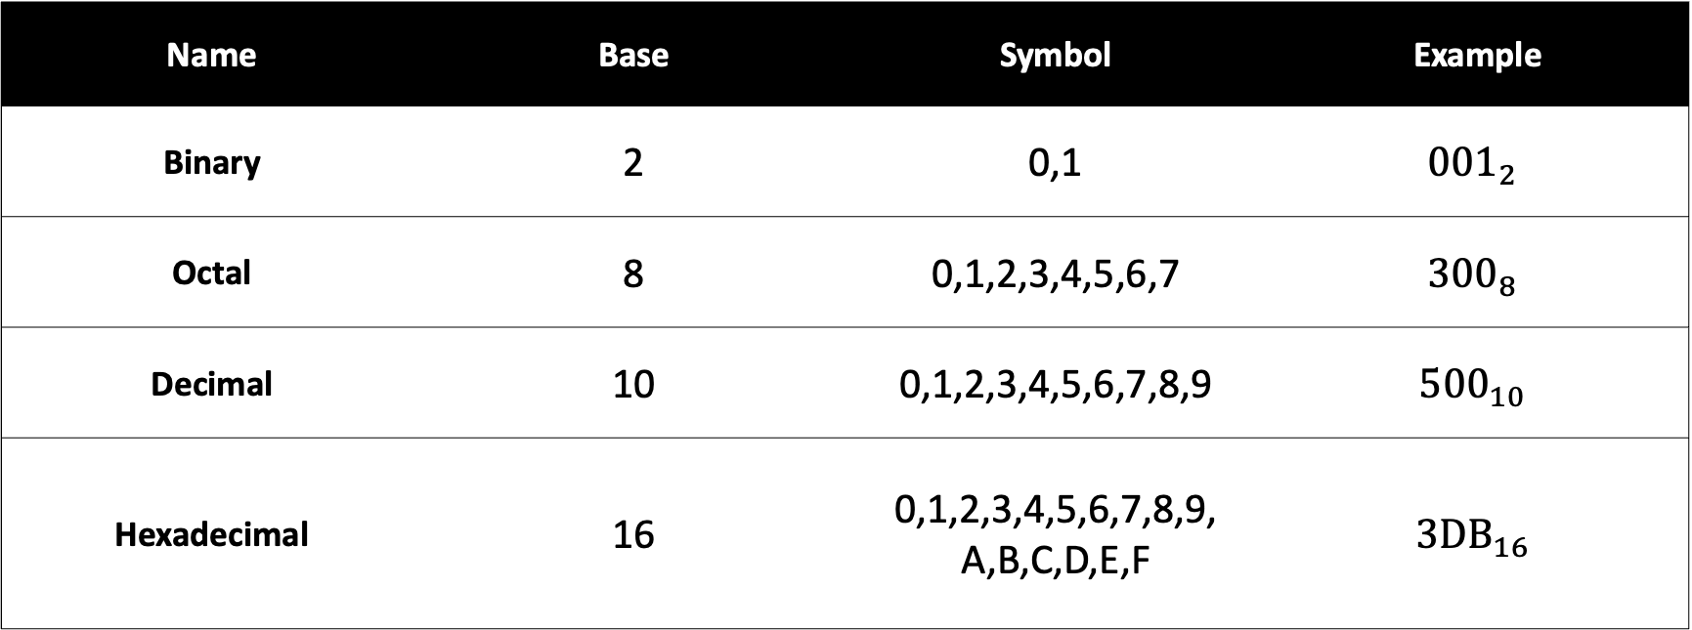
Number System
Name | Base | Symbol | Example
Binary | 2 | 0,1 | $${001}_{2}$$
Octal | 8 | 0,1,2,3,4,5,6,7 | $${300}_{8}$$
Decimal | 10 | 0,1,2,3,4,5,6,7,8,9 | $${500}_{10}$$
Hexadecimal | 16 | 0,1,2,3,4,5,6,7,8,9, A,B,C,D,E,F | $${3DB}_{16}$$

Slide 10
Conversion of Number Systems
A number can be converted from one number system to another number system using number system formulas.
Like binary numbers can be converted to octal numbers and vice versa, octal numbers can be converted to decimal numbers and vice versa, and so on.

Slide 11
Binary to Decimal

Slide 12
Binary to Decimal
To convert a number from the binary to the decimal system,
Step 1: Multiply each digit of the given number, starting from the rightmost digit, with the exponents of the base.
Step 2: The exponents should start with 0 and increase by 1 every time we move from right to left.
Step 3: Simplify each of the above products and add them.

Slide 13



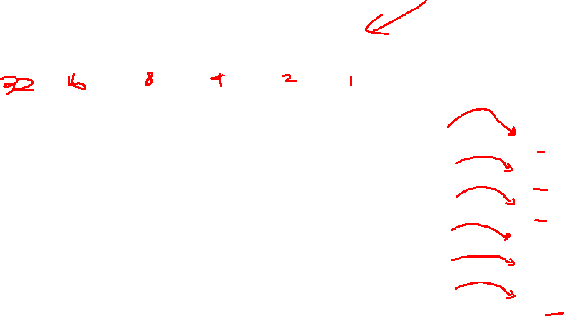



Binary to Decimal
1
0
0
1
1
1
Step 1:
Identify the base of the given number. Here, the base is 2.
Step 2:
Multiply each digit of the given number, starting from the rightmost digit, with the exponents of the base.
The exponents should start with 0 and increase by 1 every time as we move from right to left.
1 x $2^{0}$ = 1 x 1 = 1
1 x $2^{1}$ = 1 x 2 = 2
1 x $2^{2}$ = 1 x 4 = 4
0 x $2^{3}$ = 0 x 8 = 0
Step 3:
Add each product
0 x $2^{4}$ = 0 x 16 = 0
1 x $2^{5}$ = 1 x 32 = 32
Answer = 39

Slide 14
Decimal to Octal

Slide 15
Decimal to Octal
To convert a number from the decimal to the octal system,
Step 1: Identify the base of the required number. Since we have to convert the given number into the octal system, the base of the required number is 8.
Step 2: Divide the given number by the base of the required number and note down the quotient and the remainder in the quotient-remainder form.
Repeat this process (dividing the quotient again by the base) until we get the quotient less than the base.

Slide 16
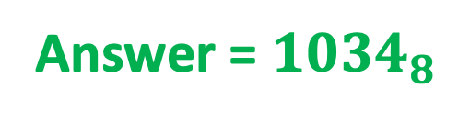
Decimal to Octal
4320
Division | Quotient | Remainder
4320 ÷ 8 | 540 | 0
540 ÷ 8 | 67 | 4
67 ÷ 8 | 8 | 3
8 ÷ 8 | 1 | 0
1 ÷ 8 | 0 | 1
Answer = ${1034}_{8}$

Slide 17
Conversion from one number system to another number system

Slide 18
Conversion from one number system to another number system
To convert a number from one number system (binary/octal/hexadecimal) systems to another number system (binary/octal/hexadecimal) :
Step 1: Convert it into the decimal system
Step 2: Convert it to the target number system.

Slide 19











Binary to Hexadecimal
1
0
1
0
1
1
1
1
0
0
0 x $2^{0}$ = 0 x 1 = 0
0 x $2^{1}$ = 0 x 2 = 0
1 x $2^{2}$ = 1 x 4 = 4
1 x $2^{3}$ = 1 x 8 = 8
1 x $2^{4}$ = 1 x 16 = 16
1 x $2^{5}$ = 1 x 32 = 32
0 x $2^{6}$ = 0 x 64 = 0
1 x $2^{7}$ = 1 x 128 = 128
0 x $2^{8}$ = 0 x 256 = 0
1 x $2^{9}$ = 1 x 512 = 512
= ${700}_{10}$

Slide 20
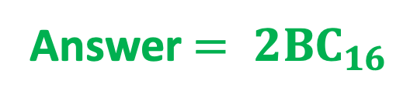
Decimal to Hexadecimal
700
Division | Quotient | Remainder
700 ÷ 16 | 43 | C
43 ÷ 16 | 2 | B
2 ÷ 16 | 0 | 2
Answer ${= 2BC}_{16}$

